Slide 1
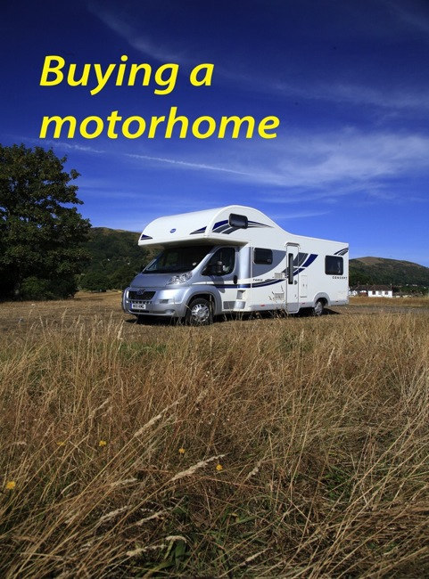
Dave Hurrell, MMM Senior Road Tester

